Slide 1

FIRST 101
The Bionic Tigers - FTC 10464

Slide 2
What is FIRST?

Slide 3
For Inspiration and Recognition of Science and Technology

Slide 4
The mission of FIRST® is to inspire young people to be science and technology leaders and innovators, by engaging them in exciting mentor-based programs that build science, engineering, and technology skills, that inspire innovation, and that foster well-rounded life capabilities including self-confidence, communication, and leadership.

Slide 5
“FIRST is more than robots. The robots are a vehicle for students to learn important life skills. Kids often come in not knowing what to expect - of the program nor of themselves. They leave, even after the first season, with a vision, with confidence, and with a sense that they can create their own future.”
-Dean Kamen

Slide 6
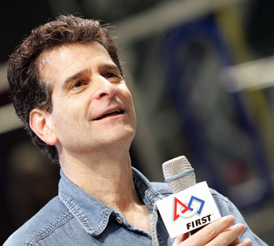
Dean Kamen
American engineer, inventor, and businessman
Cofounder of FIRST
Inventor of the Segway

Slide 7
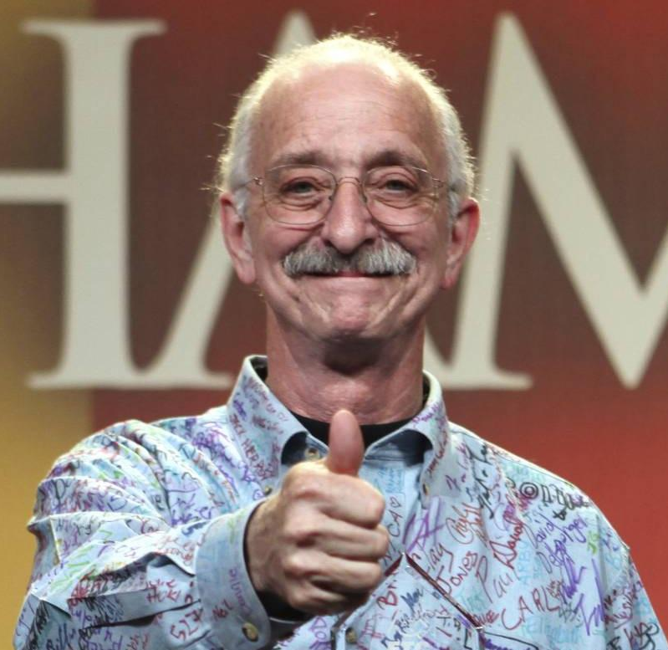
Woodie Flowers
Mechanical engineering professor at MIT
Cofounder of FIRST
Founded the idea of
“Gracious Professionalism” and “Coopertition”

Slide 8

What FIRST includes

Slide 9

FIRST Lego League Jr.
Ages 6-10
Introduction of STEM
Explore real-world theme and build a model of a solution to a problem
Mechanize and program the solution with Lego EV3 or NXT parts
Example: the theme was water, a team built an irrigation system
Create a “Show Me” poster to exhibit at an expo
Reinforces students skills and values relating to: team work, critical thinking, researching, and communication.

Slide 10

FIRST Lego League
Ages 9-14
Create and program an EV3 robot to complete objectives on field
Research and create a project relating to problems in world
Present in three judging rooms: core values, robot design, and project
Big emphasis in the core values of FIRST Lego League
Advancement is based on composite score

Slide 11

FIRST Tech Challenge
Ages 12-18
Challenge to design, build, program, and operate robots to compete in a head-to-head challenge in an alliance format (2 v 2)
Emphasis on spreading STEM and FIRST through community, school, and world
Present in one judging room to judges about their robot design, design process, programming, outreach, and the team’s journey.
Advancement is based on winning the competition or awards

Slide 12

FIRST Robotics Challenge
Ages 14-18
Under strict rules, limited time and resources, teams of students are challenged to raise funds, design a team "brand," hone teamwork skills, and build and program industrial-size robots to play a difficult field game against like-minded competitors. (3 v 3)
Encouraged to spread STEM and FIRST through community, school, and world
Advancement is whole winning alliance, Chairman’s Award, and lottery

Slide 13
Etiquette

Slide 14
Gracious Professionalism
Definition: demonstrating gracious attitudes and behaviors during competitions, respecting others and letting that respect show through actions, and making valued contributions in a way that is pleasing to others
Why is it important to be gracious professionals at competitions?
Judges look for teams who show gracious professionalism for every award
It can preclude your team from being considered for awards
It builds respect for your team
It extends beyond your team - it applies to your supporters
Give help and don’t be afraid to ask for it! Cooperation over competition
Practicing gracious professionalism in the presence of volunteers and respecting them is important
Practice in everyday life too!

Slide 15
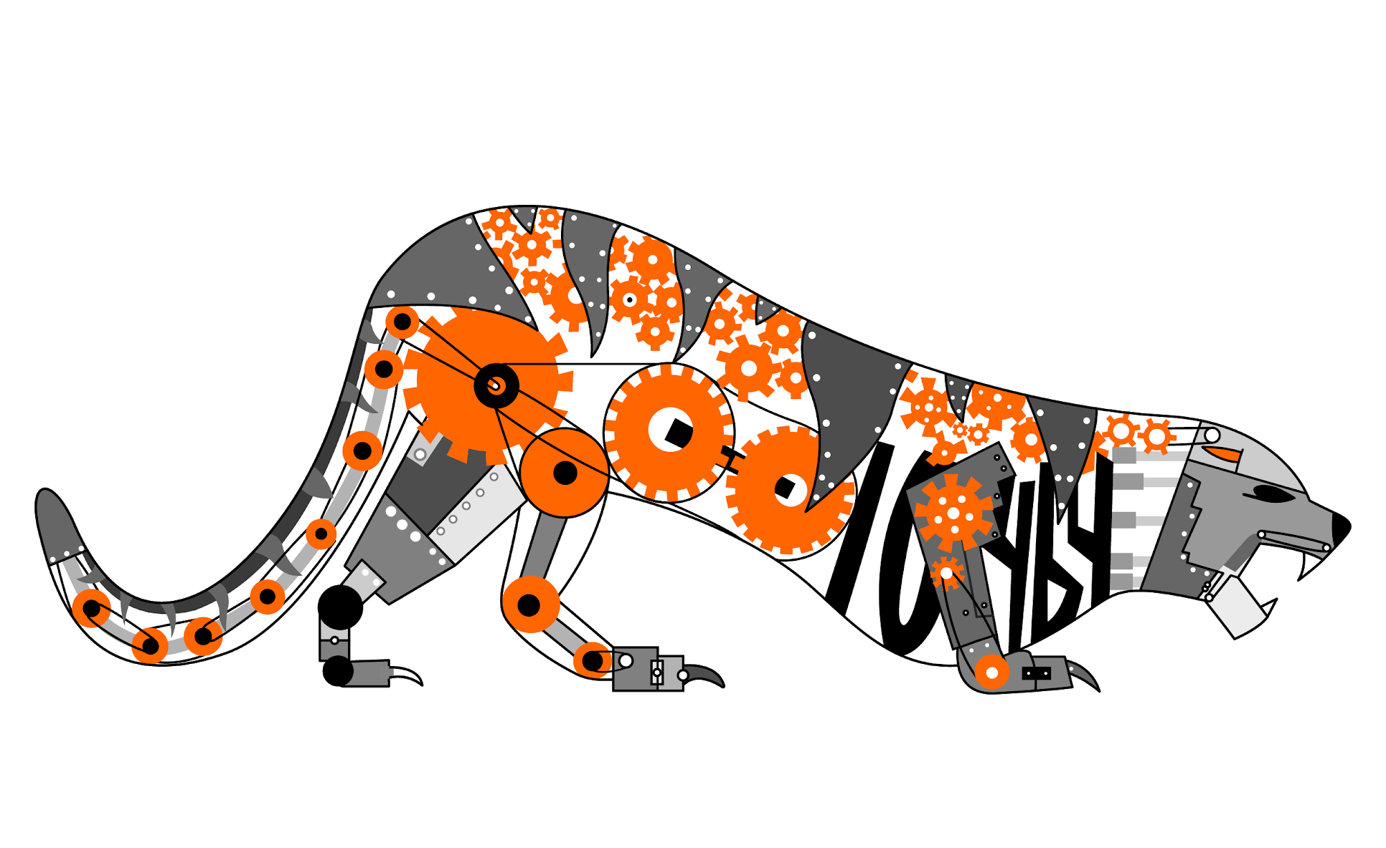

Credits
This lesson was written by The Bionic Tigers 10464 for FTCTutorials.com
You can contact the author at:
Website:
http://lovelandrobotics.com/team10464
Twitter:
@BionicTigersFTC
Email:
BionicTigers10464@gmail.com
More lessons for FIRST Tech Challenge are available at www.FTCtutorials.com
This work is licensed under a
Creative Commons Attribution-NonCommercial-ShareAlike 4.0 International License.

